Slide 1
Burp Suite
By –Prakash Khasor, Assistant Professor(Cyber Security), National Forensic Sciences University

Slide 2

Introduction
What is Burp suite?
Why we need to use Burp Suite?

Slide 3
Burp Suite?
Burp Suite is an integrated platform for performing security testing of web applications. Its various tools work seamlessly together to support the entire testing process, from initial mapping and analysis of an application's attack surface, through to finding and exploiting security vulnerabilities.

Slide 4
Proxy
Proxy is the most useful feature of the Burp suite and must be understood before proceeding to any other feature . Burp Suite comes with an inbuilt proxy, which is configured and run on port 8080 by default(however we can always change the port number as per the requirements of the penetration test).
Check that the proxy is running by clicking on – Proxy > Options
There should be a check box under the “Running” column to indicate that the proxy is running

Slide 5
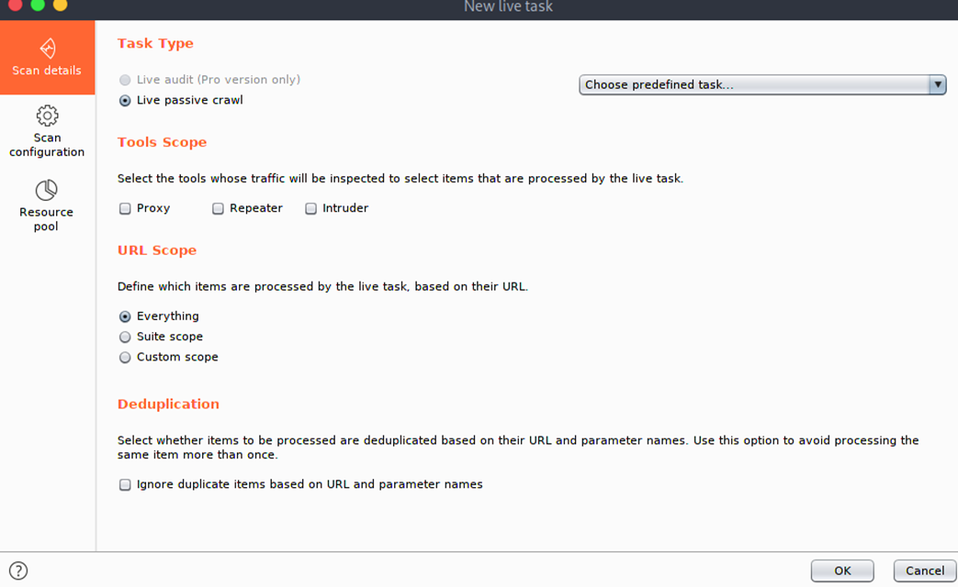
Spider
The spider feature of Burp Suite is used to crawl web applications and look for new links, content, etc. It automatically submits login forms (through user defined input) in case it finds any, and looks for new content from the responses.

Slide 6
Scanner
It is used to scan web applications for vulnerabilities. The type of scanning can be passive, active or user-directed. Some false positives might occur during the tests

Slide 7
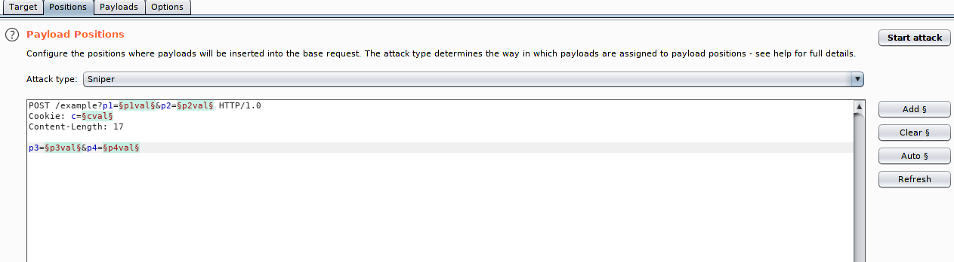
Intruder
Common Password Attack:-
1.Dictionary Attack
2. Brute Force Attack
3.Phishing
-Spoofing
4. Rainbow Table Attack:-
->Encoding
->Encryption
->Hashing
5. Credential Stuffing
6. Password Spraying
7. Keylogger Attack
Prevention:-
MFA
This feature can be used for various purposes like exploiting vulnerabilities, fuzzing web applications, carrying out brute force attacks etc. Burp Intruder can be used for exploiting vulnerabilities, fuzzing, carrying out brute force attacks and many other purposes.

Slide 8
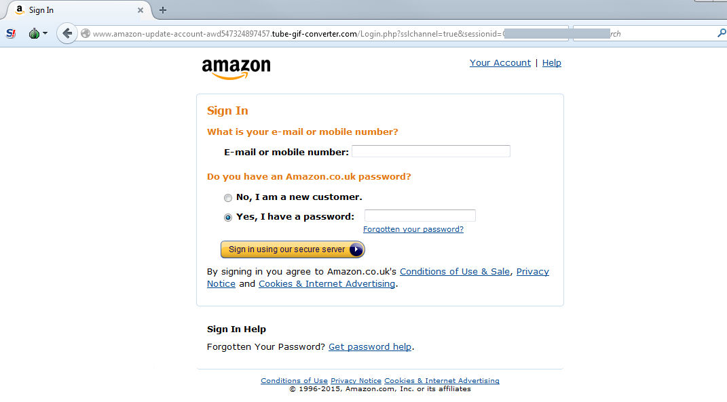

Slide 9
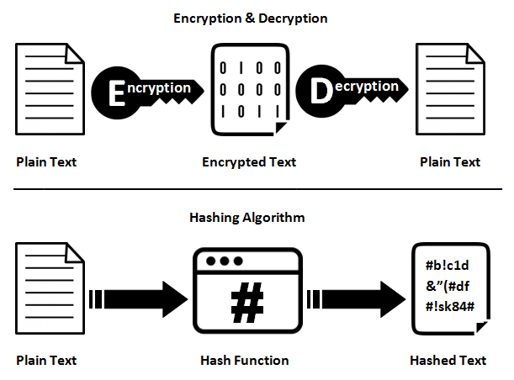

Slide 10
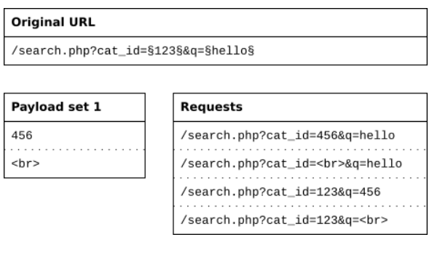
Conti….Payload Positions
Sniper:-The sniper attack uses only one payload set, and it replaces only one position at a time.

Slide 11
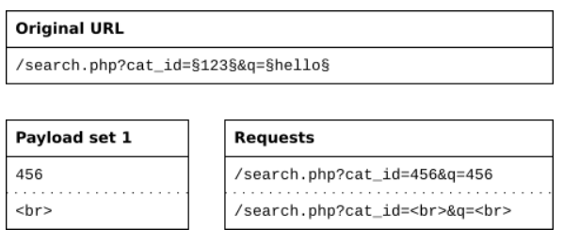
Conti….Payload Positions
Battering ram:-The battering ram attack type places the same payload value in all positions. It uses only one payload set.

Slide 12
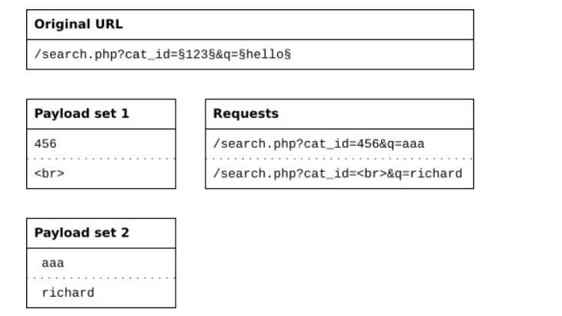
Conti….Payload Positions
Pitchfork:-The pitchfork attack type uses one payload set for each position. It places the first payload in the first position, the second payload in the second position, and so on

Slide 13
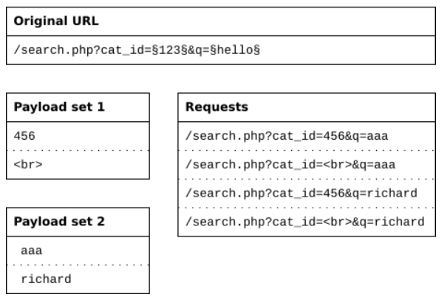
Conti….Payload Positions
Clusterbomb:-The cluster bomb attack tries all different combinations of payloads. It still puts the first payload in the first position, and the second payload in the second position. But when it loops through the payload sets, it tries all combinations.

Slide 14
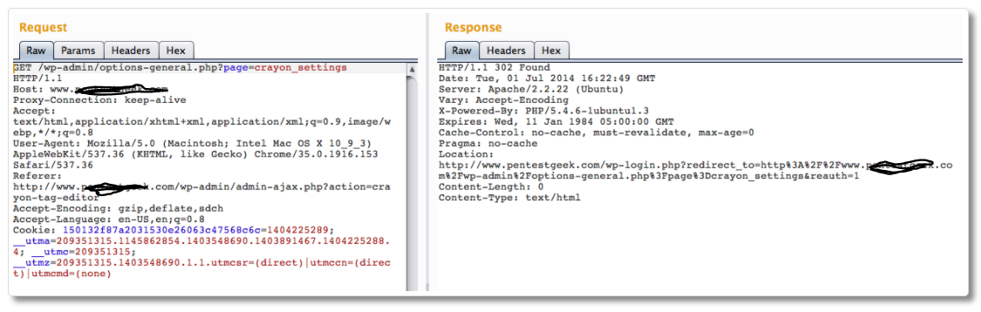
Repeater
This feature is used to modify and send the same request a number of times and analyze the responses in all those different cases.

Slide 15
Sequencer
This feature is mainly used to check the randomness of session tokens provided by the web application. It performs various advanced tests to figure this out.Burp Suite Sequencer is used to figure out the randomness of the session tokens generated by a web application

Slide 16
Decoder
Decoder feature is utilized to decode data to get back the original form, or to encode and encrypt the data. Burp Suite Decoder can be used to decode encoded data and get it back into its canonical form.

Slide 17
Comparer
Comparer feature of the Burp Suite is used to perform a comparison between any two requests, responses or any other form of data.

Slide 18


